Slide 1
A RUGD Dataset for Visual Perception in Unstructured Outdoor Environments
Maggie Wigness¹, Sungmin Eum^{1,2}, John G. Rogers III¹, David Han¹, Heesung Kwon¹
¹CCDC Army Research Laboratory, ²Booz Allen Hamilton
IROS 2019
06 NOV 2019

Slide 2
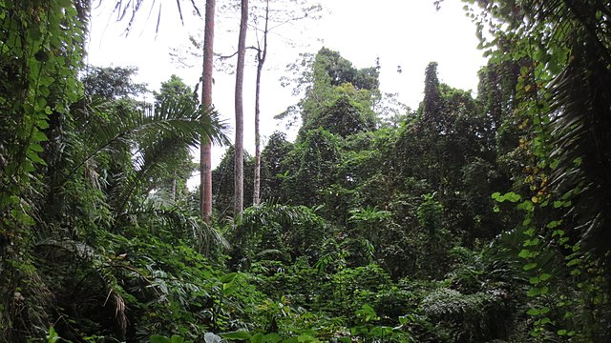
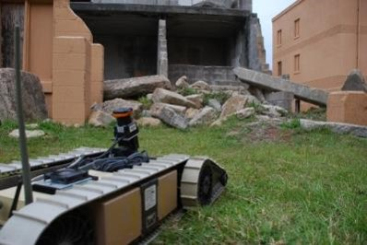
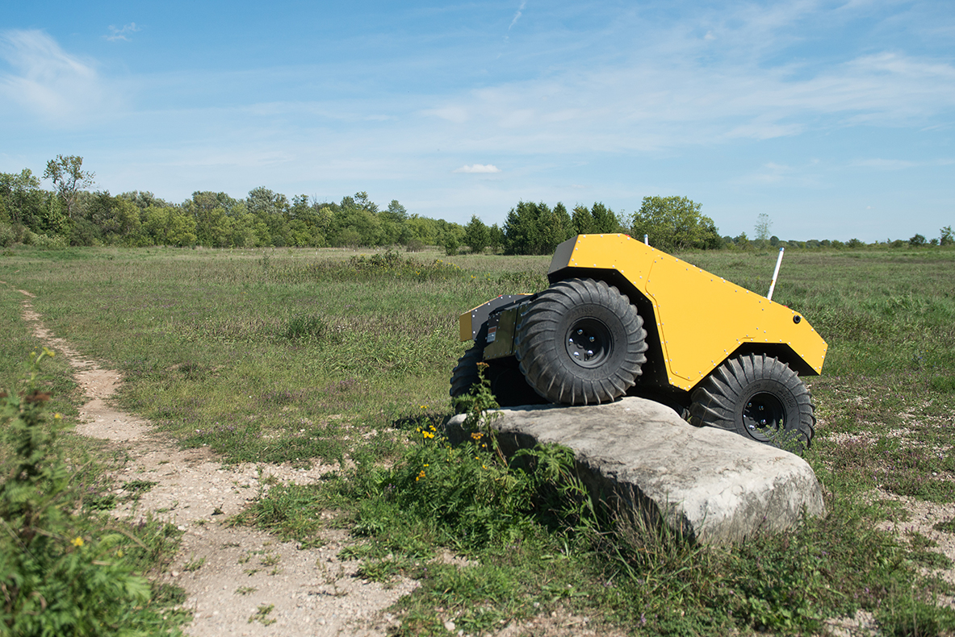
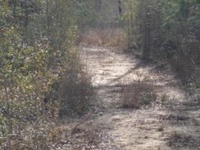
motivation
There is a need for autonomous navigation in highly unstructured environments, where off-road traversal is the norm
  Humanitarian Assistance and Disaster Relief
  Agricultural robotics
  Environmental surveying in hazardous areas
  Military operation
https://www.clearpathrobotics.com/warthog-unmanned-ground-vehicle-robot/
rugd.vision

Slide 3
Machine learning for autonomous navigation
Visual perception has made great advancements and is a primary source of input to reason about environments
  Detect and track other moving objects to avoid collisions
  Identify terrain to path plan for easy maneuver
  Identify and avoid obstacles to maintain vehicle stability and integrity
Need: Representative visual datasets with ground truth annotations for learning
Problem: Existing datasets are not representative of challenging unstructured environment applications
rugd.vision

Slide 4
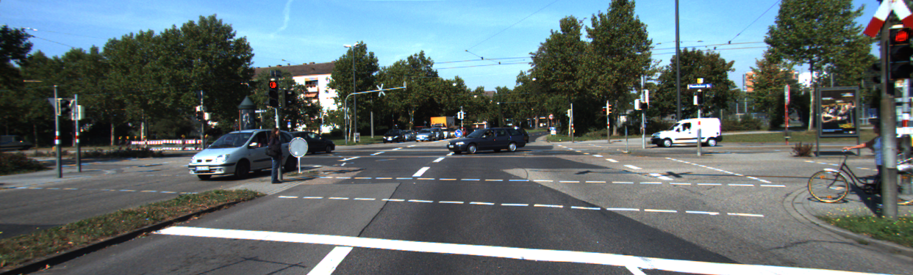
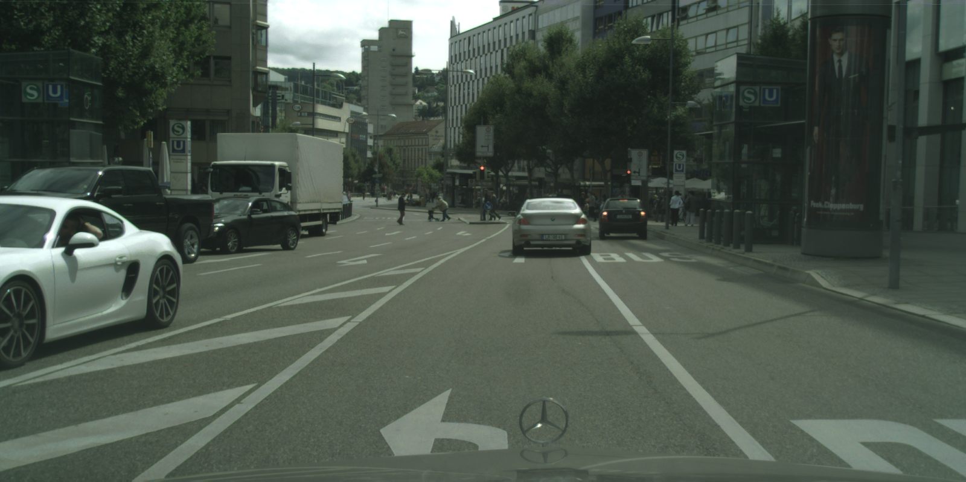
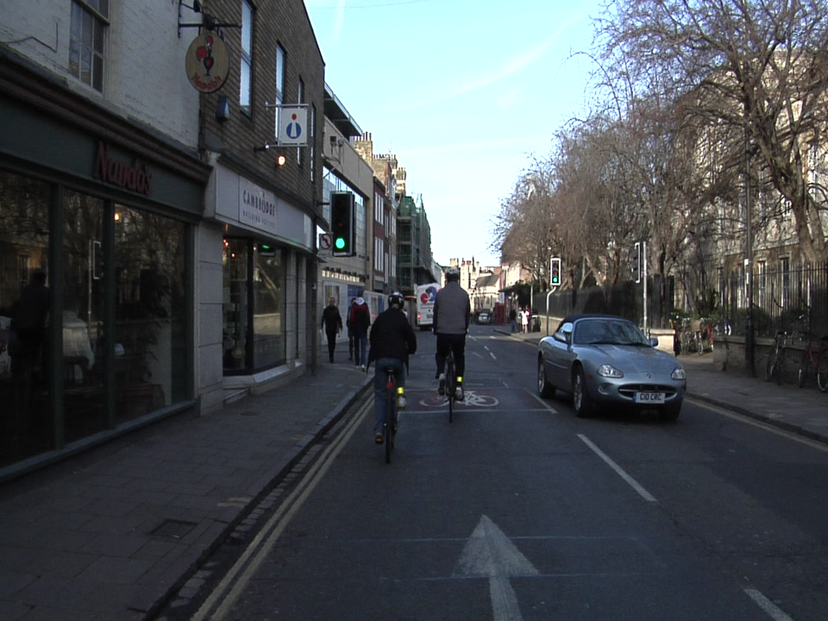
Existing datasets
Existing autonomous driving datasets represent
  Real world highly populated, urban cities
  Highly structured scenes
KITTI
Cityscapes
CamVid
rugd.vision

Slide 5
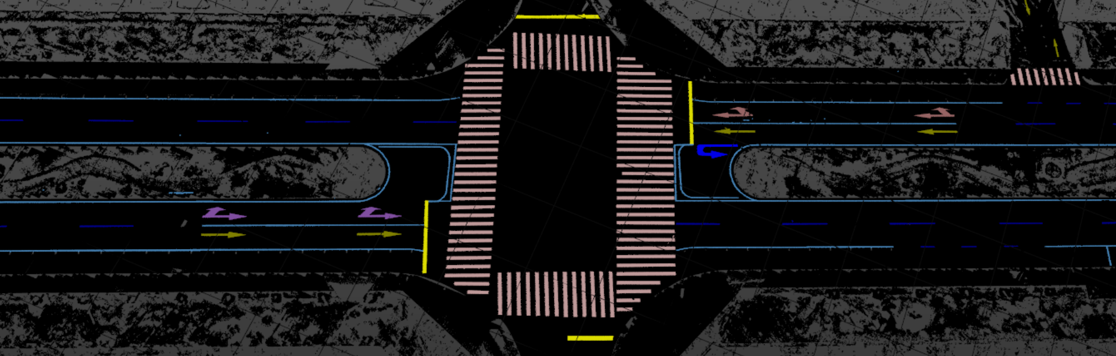
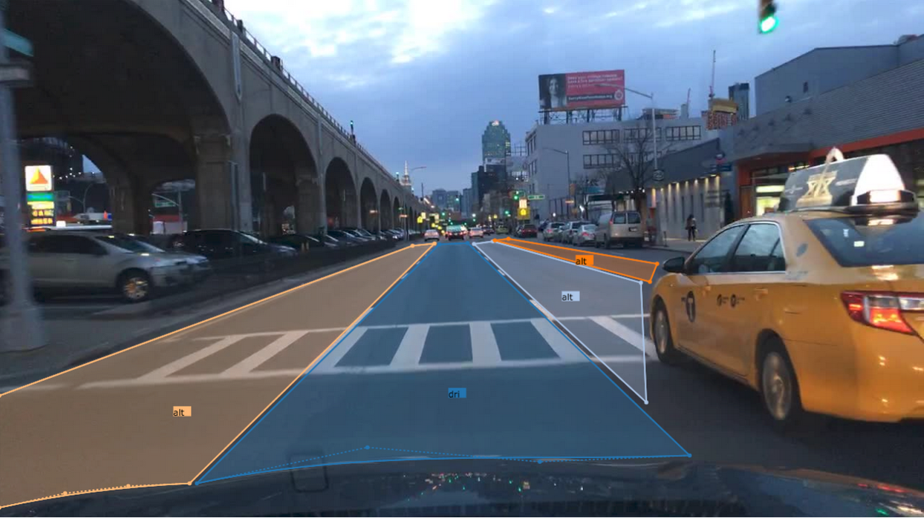
Existing datasets
Existing autonomous driving datasets include
  Annotated structured cues
  Object classes known to exist in highly populated urban areas, e.g., pedestrians, cyclists, and vehicles
Apolloscape – lane marking annotations
Berkeley DeepDrive – drivable area markings
rugd.vision

Slide 6
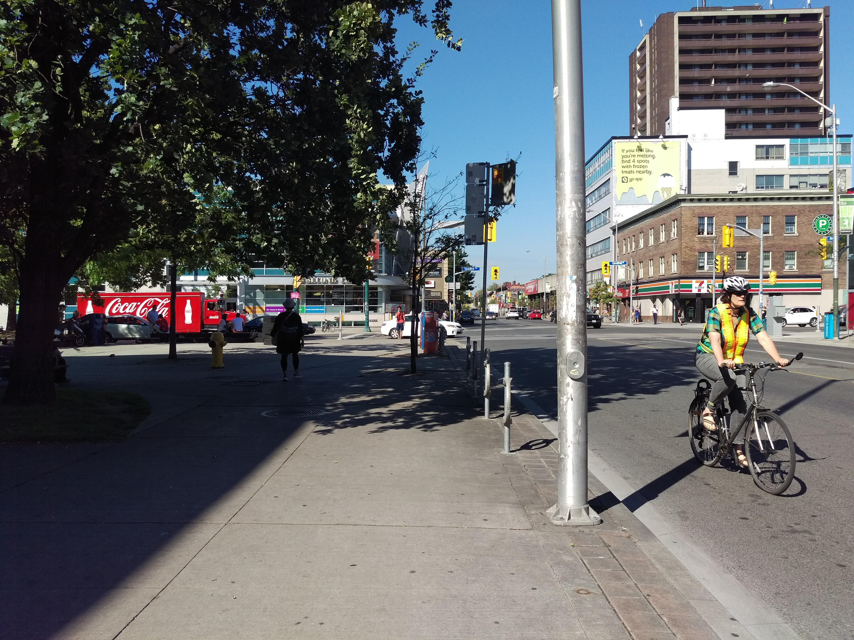
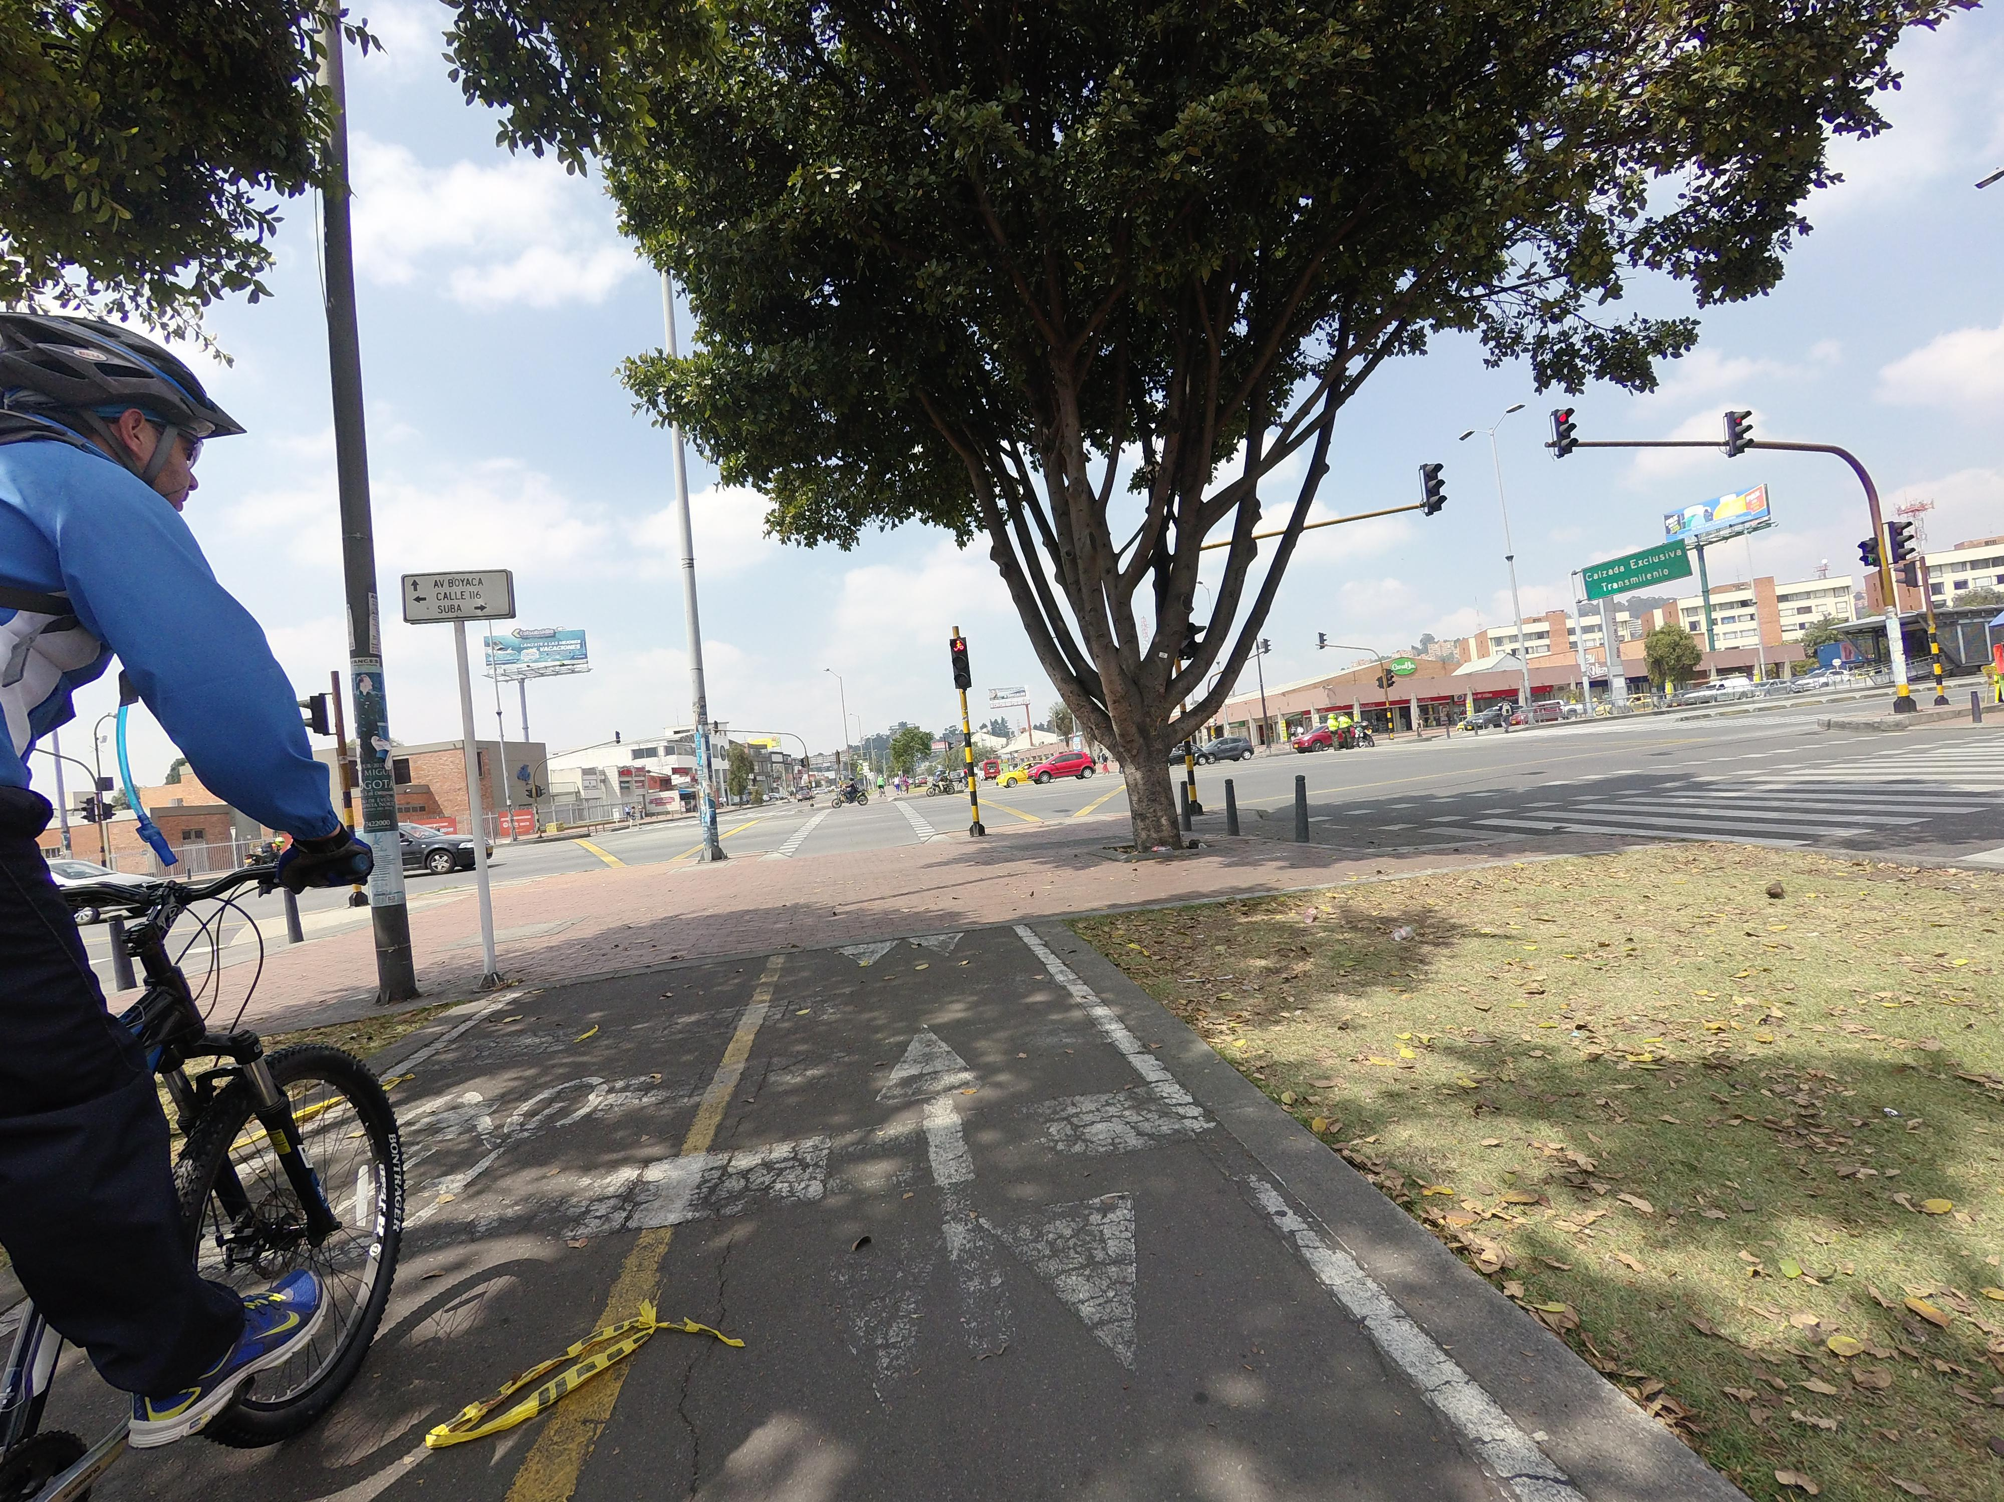
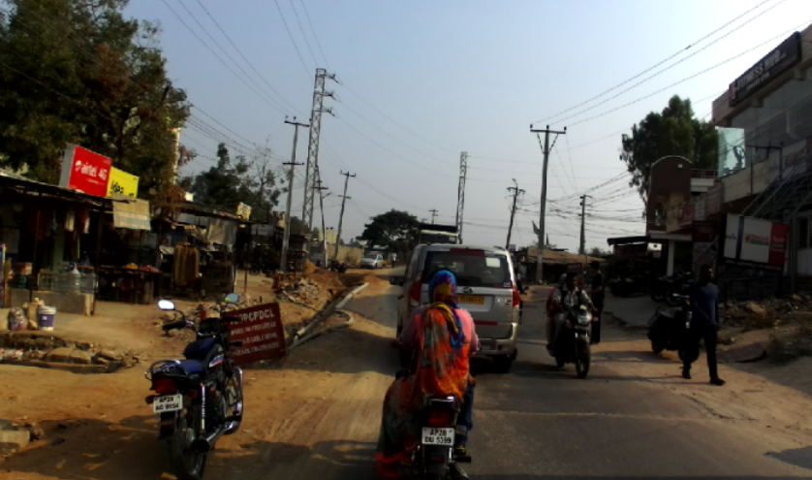
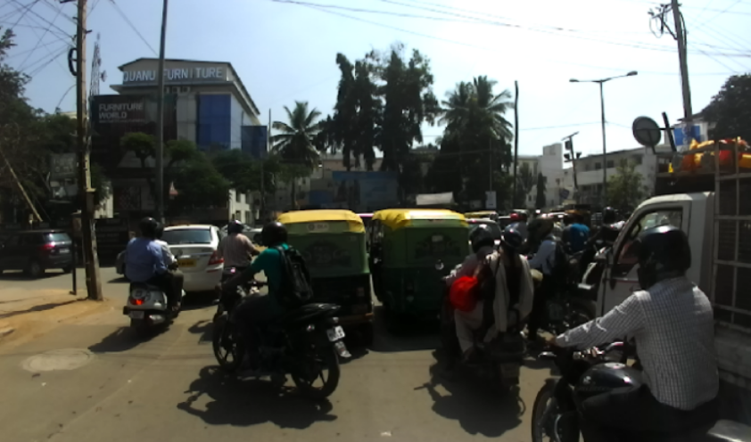
Existing datasets
Beginning to see an emergence of data that introduces small unstructured qualities
  Imagery captured from camera not on a moving vehicle in the roadway
  Environments with non-paved driving areas
Mapillary Vistas
India Driving Dataset
rugd.vision

Slide 7
Machine learning for autonomous navigation
Research effort has focused on areas well-represented by existing datasets – commercially relevant urban city autonomous navigation
Research efforts in navigation of unstructured environments lack fine-grained semantic understanding
  Binary classification of terrain (traversable vs non-traversable) in programs like DARPA BigDog and LAGR
  Robots operate with binary terrain costs – limits traversal behavior of a platform
Contribution: Curation of a video dataset with dense fine-grained semantic pixel-wise annotations that is representative of unstructured environments
RUGD: Robot Unstructured Ground Driving dataset
rugd.vision

Slide 8
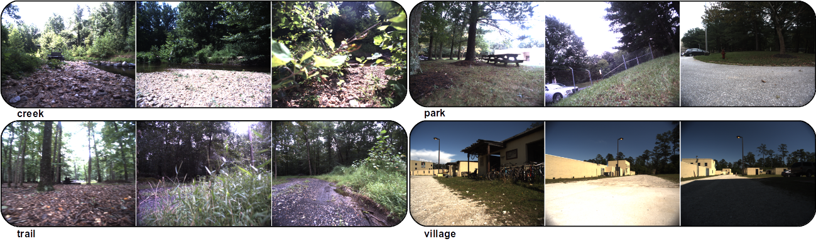
RuGD dataset details
18 video sequences collected from a mobile robot platform
  Frame rate: 15 Hz
  Average Length: ~3 minutes
  Processed Resolution: 688x555
Collected data from four unstructured environment categories
Challenging characteristics and unique contributions
Fine-grained terrain differentiation Irregular class boundaries
Scenes with no discernable edges Illumination changes
Unique viewpoints from sloped terrain Dense vegetation occlusion
Blurred frames from off-road traversal Harsh shadows
rugd.vision

Slide 9
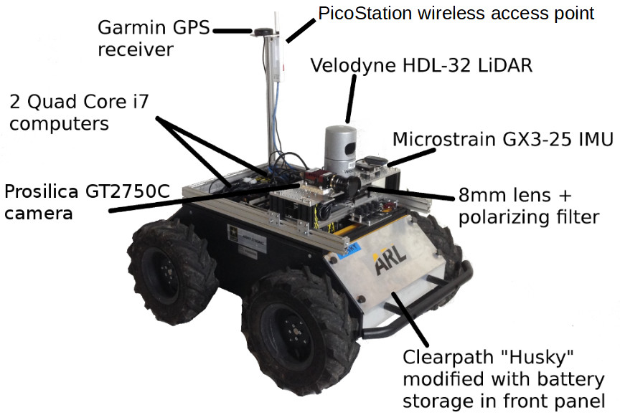
Robot platform
Clearpath Husky
  External dimensions: 990 x 670 x 390 mm
  Top speed: 1 m/s
  Camera sensor is mounted in front of the platform 25 cm off ground
Prosilica GT2750C camera
  6.1 megapixels
  Max frame capture: 19.8 Hz
  8mm lens with wide depth of field
Other sensors onboard the robot were used to actively capture data for future dataset additions
rugd.vision

Slide 10
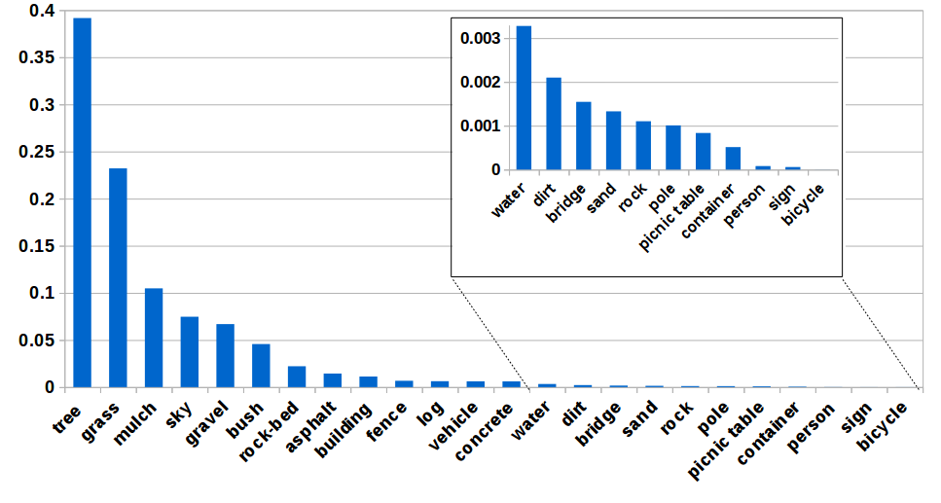
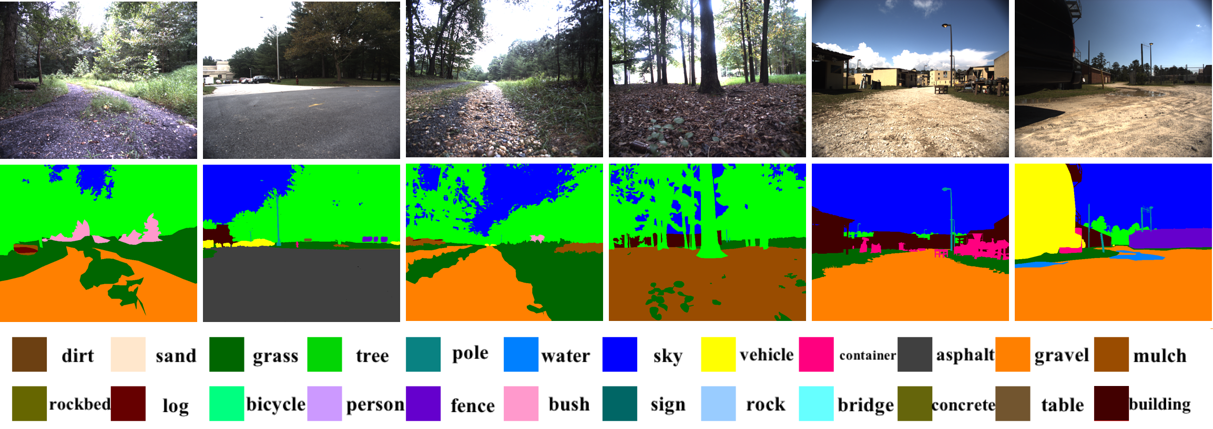
Annotation ontology and statistics
Category Distribution
24 category annotations
  8 unique ground terrains
7,453 densely annotated images (every 5th frame in a video)
  Outsourced annotation to the labeling platform Figure Eight
Raw frame
Annotation
rugd.vision

Slide 11
Semantic segmentation benchmark
Like many other existing datasets we focus the initial annotation release on semantic segmentation
Ran an initial benchmark on RUGD with SoA techniques
Split train/val/test set by video
Standard evaluation metrics
  mIoU
  pixel-wise accuracy
  mean pixel-wise accuracy
Encoder
e1: ResNet-50 with dilated Convolution (Size = 8)
e2: ResNet-50 without dilated Convolution
 | # Videos | % Frames
train | 12 | 63.8
val | 2 | 9.8
test | 4 | 26.3
Decoder
d1: bilinear upsampling + *deep supervision
d2: Pyramid Scene Parsing Network (PSPNet)
d3: PSPNet + * deep supervision
d4: Unified Perceptual Network (UPerNet)
Baseline Models
m1: e1 + d1
m2: e1 + d2
m3: e1 + d3
m4: e2 + d4
* deep supervision
an auxiliary loss imposed in addition to the original softmax loss which is to train the final classifier
decomposes network optimization into two easier problems
rugd.vision

Slide 12
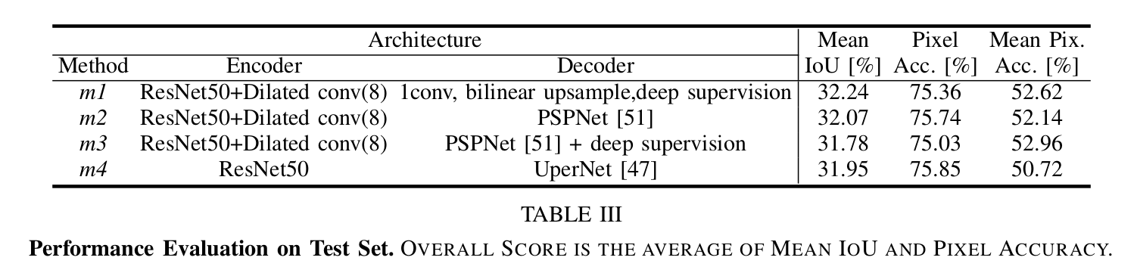
Initial benchmark results
Lowest accuracies: dirt, rock, container, person (sparse annotations)
Terrain class accuracies below the mean: dirt, asphalt, and gravel
Large room for improvement with respect to mIoU
  Classes with high pixel accuracy still have low IoU
  IoU is a critical performance metric in autonomous navigation applications as it may translate to steering errors
Category: rock bed
Pixel Accuracy [%] | Class IoU [%]
97.76 | 9.77
97.89 | 11.76
97.53 | 8.86
97.97 | 9.61
rugd.vision

Slide 13
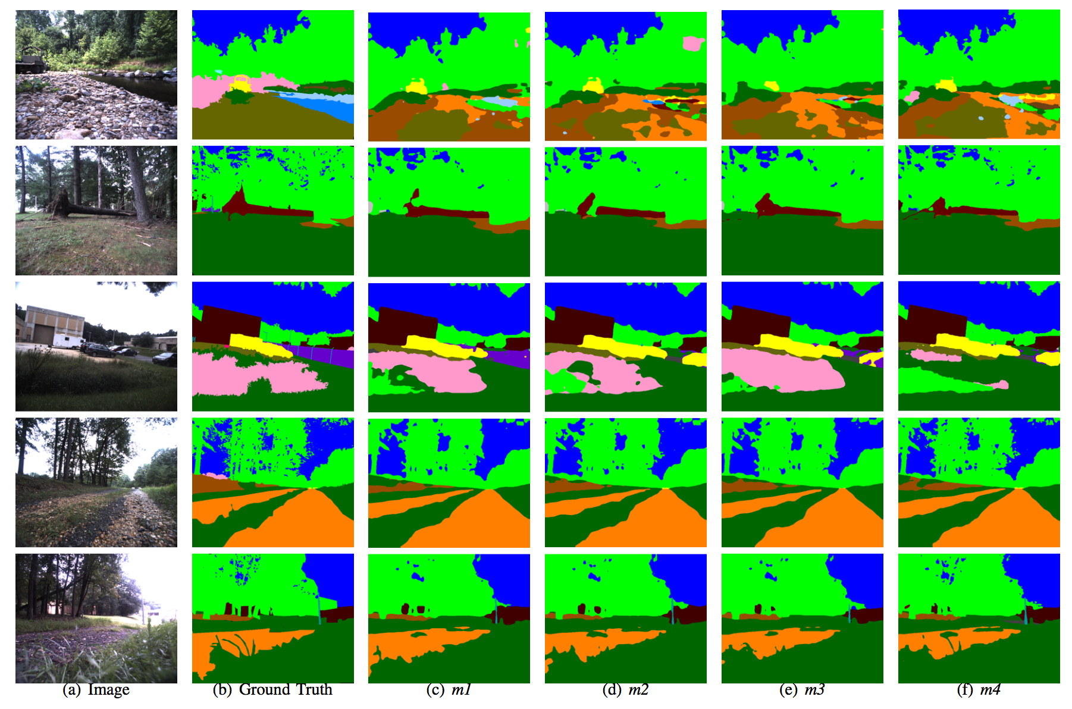
Qualitative benchmark evaluation
Models have a difficult time identifying precise boundaries between terrains, where classes like grass, tree, bush, and mulch do not exhibit structured edges
rugd.vision

Slide 14
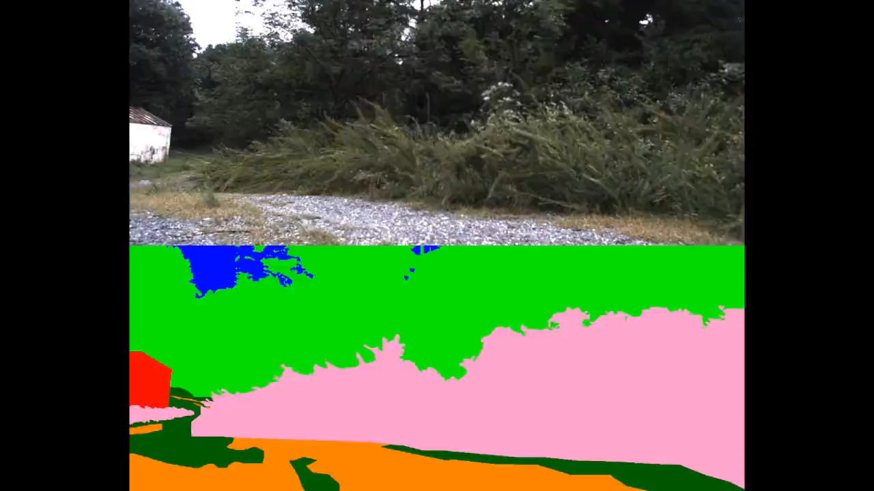
Summary
RUGD includes high frame rate videos captured from a mobile robot exploring unstructured environments
Over 7,000 dense pixel annotations for semantic segmentation
Initial benchmark for semantic segmentation on RUGD
Available Now
rugd.vision
rugd.vision

Slide 15
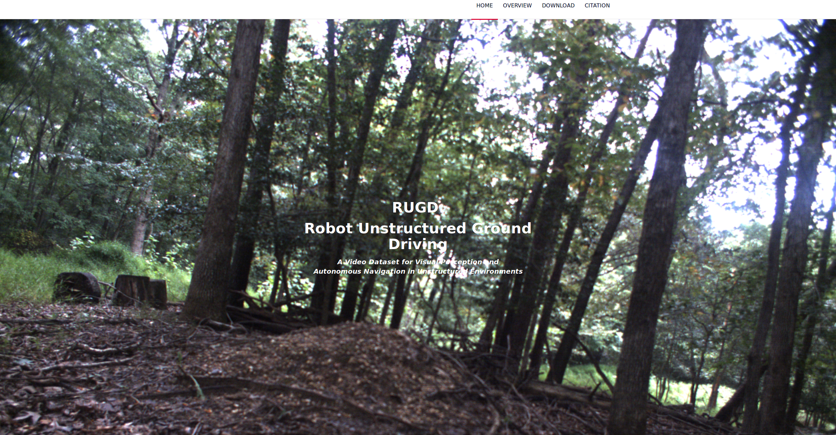
Questions
Thank you
Questions?
Data Website: rugd.vision
POC for off-line questions about RUGD: Maggie Wigness
maggie.b.wigness.civ@mail.mil
rugd.vision

